Slide 1
Indexing and Authorization Prof Dr Melike Sah Direkoglu

Slide 2
Outline
Index Definition in SQL
Authorization
Notes:
1

Slide 3
Indexing

Slide 4
What is an Index?
An index is a database structure that you can use to improve the performance of database activity.
A database table can have one or more indexes associated with it.
An index is defined by a field expression that you specify when you create the index using create index command:
create index <name> on <relation-name> (attribute);

Slide 5
Index
Many queries reference only a small proportion of the records in a table.
It is inefficient for the system to read every record to find a record with particular value
An index on an attribute of a relation is a data structure that allows the database system to find those tuples in the relation that have a specified value for that attribute efficiently, without scanning through all the tuples of the relation.

Slide 6
Index Creation Example
create table student (ID varchar (5), name varchar (20) not null, dept_name varchar (20), tot_cred numeric (3,0) default 0, primary key (ID))
create index studentID_index on student(ID)
The query:
select * from student where ID = '12345'
can be executed by using the index to find the required record, without actually looking at all records of student from the memory

Slide 7
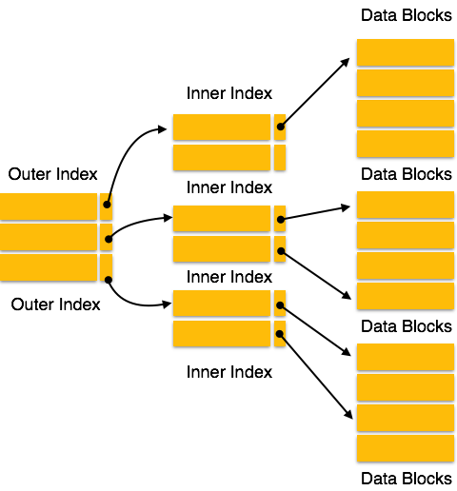
How Indexing Works?

Slide 8
What is the structure of an index?
Indexes can be created using some database columns. The first column of the database is the search key that contains a copy of the primary key or candidate key of the table.
The values of the primary key are stored in sorted order so that the corresponding data can be accessed easily.

Slide 9
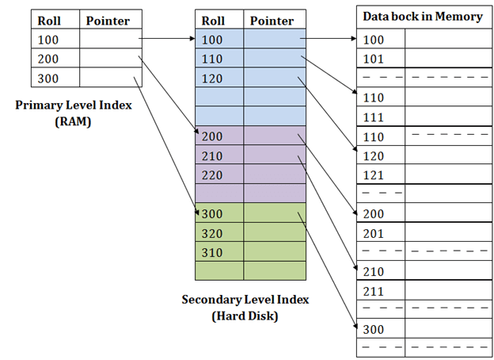
DBMS Indexing Structure

Slide 10
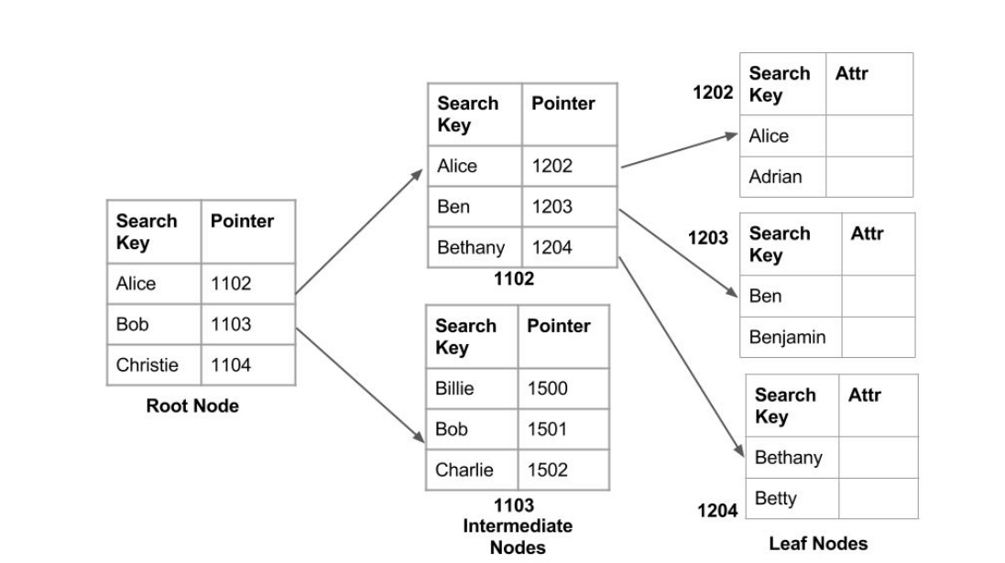
DBMS Indexing Structure (Cont.)

Slide 11
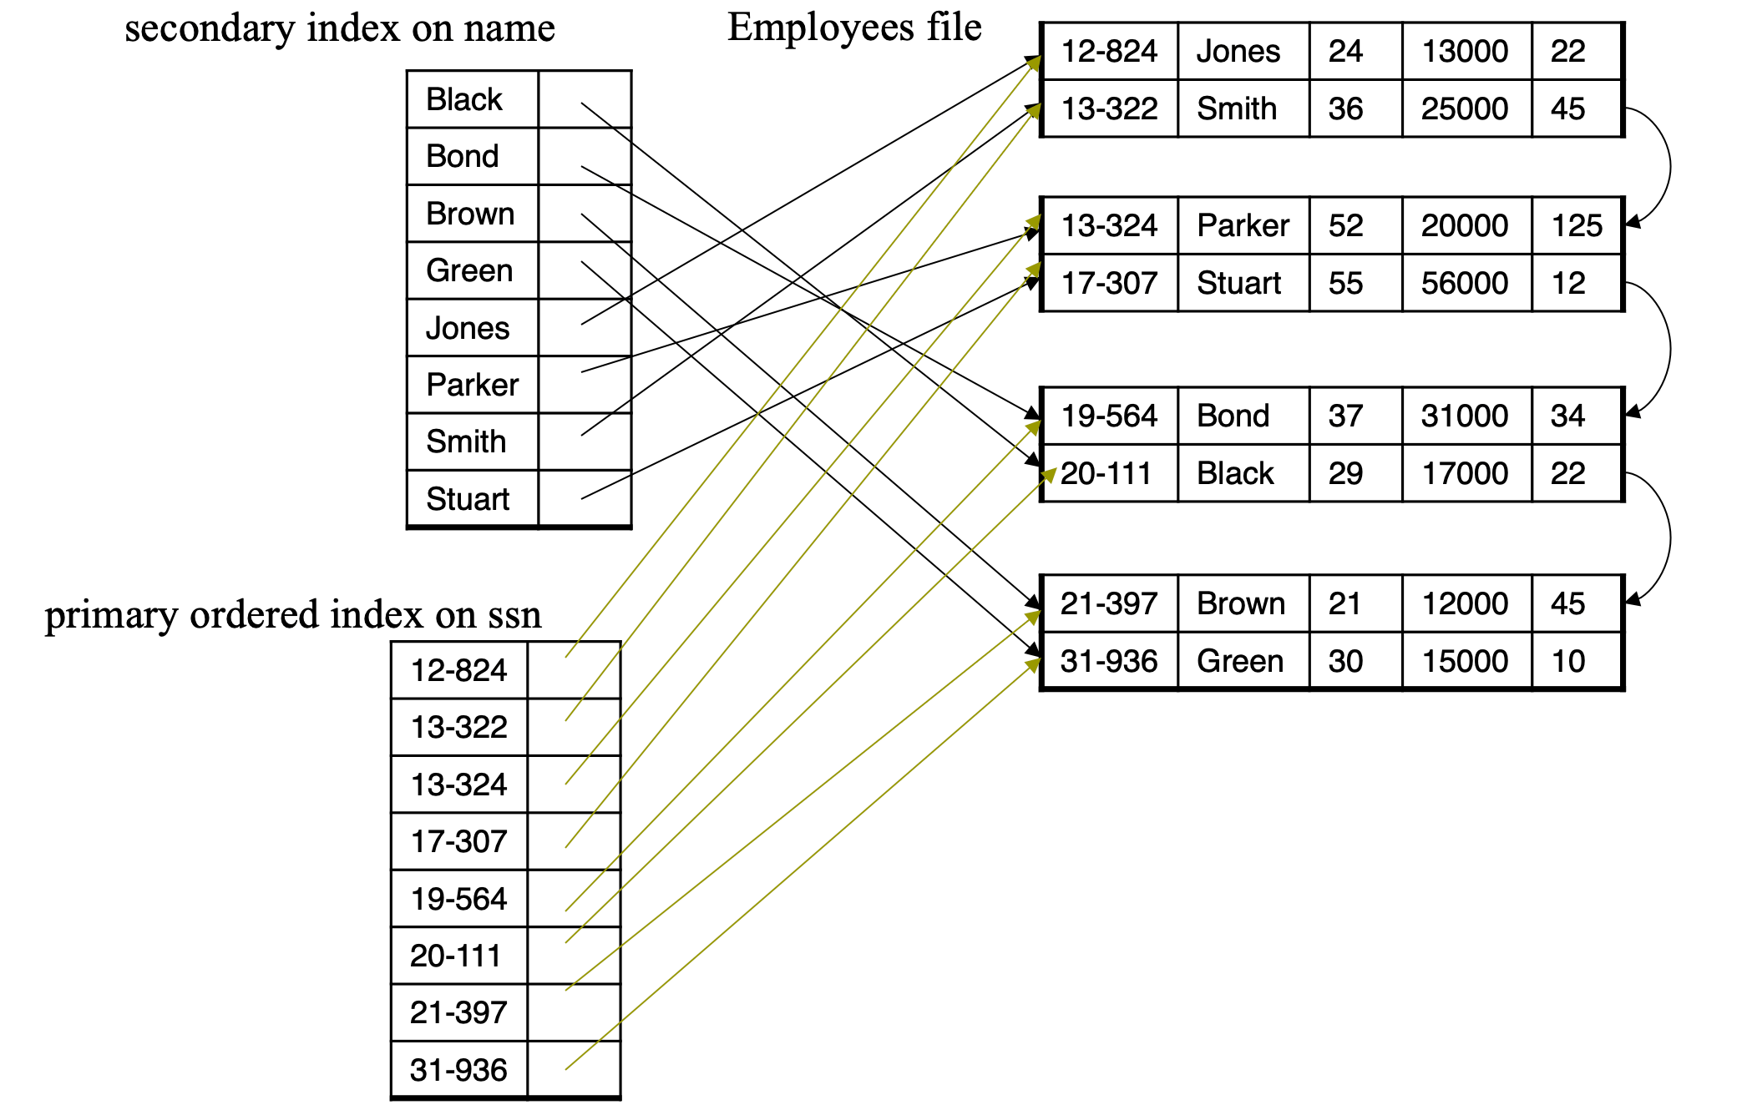
Primary and Secondary Index on the Same Table

Slide 12
Authorization

Slide 13
Authorization
We may assign a user several forms of authorizations on parts of the database.
Read - allows reading, but not modification of data.
Insert - allows insertion of new data, but not modification of existing data.
Update - allows modification, but not deletion of data.
Delete - allows deletion of data.
Each of these types of authorizations is called a privilege. We may authorize the user all, none, or a combination of these types of privileges on specified parts of a database, such as a relation or a view.

Slide 14
Authorization (Cont.)
Forms of authorization to modify the database schema
Index - allows creation and deletion of indices.
Resources - allows creation of new relations.
Alteration - allows addition or deletion of attributes in a relation.
Drop - allows deletion of relations.

Slide 15
Authorization Specification in SQL
The grant statement is used to confer authorization
grant <privilege list> on <relation or view > to <user list>
<user list> is:
a user-id
public, which allows all valid users the privilege granted
A role (more on this later)
Example:
grant select on department to Amit, Satoshi
Granting a privilege on a view does not imply granting any privileges on the underlying relations.
The grantor of the privilege must already hold the privilege on the specified item (or be the database administrator).

Slide 16
Privileges in SQL
Authorization on the instructor relation
select: allows read access to relation, or the ability to query using the view
grant select on instructor to U₁, U₂, U₃
insert: the ability to insert tuples
grant insert on instructor to U₁, U₂, U₃
update: the ability to update using the SQL update statement
grant update on instructor to U₁, U₂, U₃
delete: the ability to delete tuples.
grant delete on instructor to U₁, U₂, U₃
all privileges: used as a short form for all the allowable privileges
grant ALL PRIVILEGES on U₁.* to U₁

Slide 17
Revoking Authorization in SQL
The revoke statement is used to revoke authorization.
revoke <privilege list> on <relation or view> from <user list>
Example:
revoke select on student from U₁, U₂, U₃
<privilege-list> may be all to revoke all privileges the revokee may hold.
If <revokee-list> includes public, all users lose the privilege except those granted it explicitly.
If the same privilege was granted twice to the same user by different grantees, the user may retain the privilege after the revocation.
All privileges that depend on the privilege being revoked are also revoked.

Slide 18
Roles
A role is a way to distinguish among various users as far as what these users can access/update in the database.
To create a role we use:
create a role <name>
Example:
create role manager
Once a role is created we can assign “users” to the role using:
grant <role> to <users>
Example:
grant manager to U₁

Slide 19
Roles Example
Create an instructor role and assign Amit to the instructor role
create role instructor;
grant instructor to Amit;
Privileges can be granted to the roles:
Example: Grant select privilege for the takes table for the instructor role
grant select on takes to instructor;
(To all instructors)
Example: Grant insert privilege for the takes table for the instructor role
grant insert on takes to instructor;

Slide 20
Roles Example
Roles can be granted to users, as well as to other roles
Example: Create a teaching_assistant role and then grant teaching_assistant to instructor
create role teaching_assistant
grant teaching_assistant to instructor;
Instructor inherits all privileges of teaching_assistant

Slide 21
Roles Example
Chain of roles
create role dean;
grant instructor to dean;
grant dean to Satoshi;

Slide 22
Authorization on Views
create view geo_instructor as (select * from instructor where dept_name = 'Geology’);
grant select on geo_instructor to geo_staff
Suppose that a geo_staff member issues
select * from geo_instructor;
What if
geo_staff does not have permissions on instructor?
Creator of view did not have some permissions on instructor?

Slide 23
Other Authorization Features
references privilege to create foreign key
grant reference (dept_name) on department to Mariano;
Why is this required?
Transfer of privileges
grant select on department to Amit with grant option;
revoke select on department from Amit, Satoshi cascade;
revoke select on department from Amit, Satoshi restrict;
And more!

Slide 24
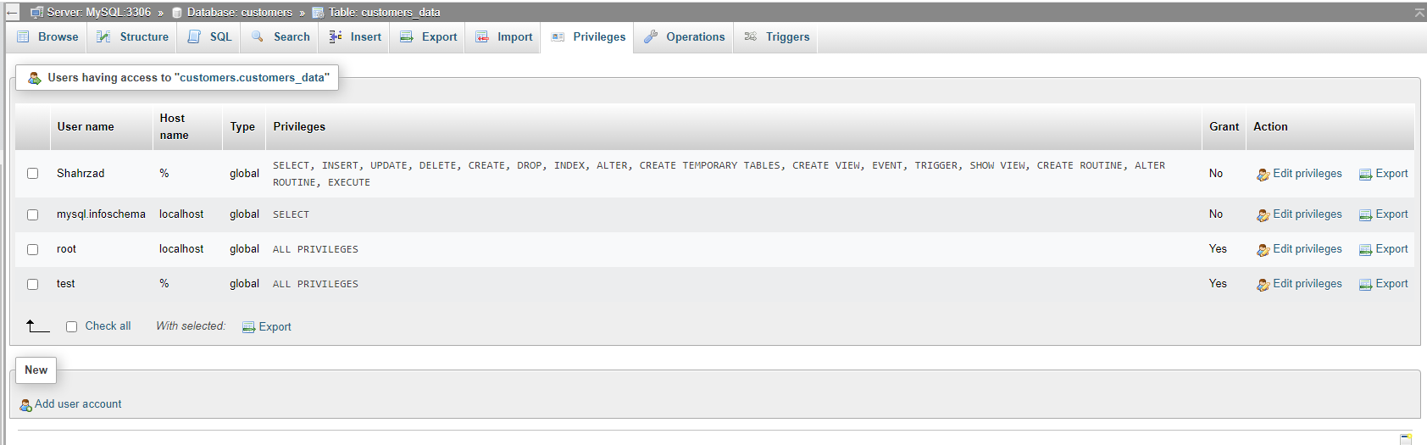
MySQL Creating New Users and Granting Privileges

Slide 25
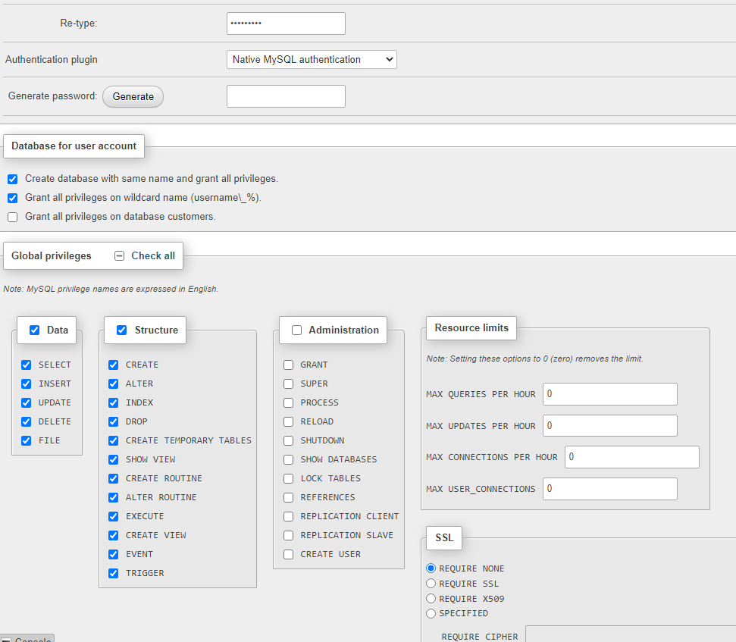

Slide 26
Creating and Granting Privileges to User1 As a SQL Query
CREATE USER 'user1'@'%' IDENTIFIED WITH mysql_native_password BY '***’;
GRANT SELECT, INSERT, UPDATE, DELETE, CREATE, DROP, FILE, INDEX, ALTER, CREATE TEMPORARY TABLES, CREATE VIEW, EVENT, TRIGGER, SHOW VIEW, CREATE ROUTINE, ALTER ROUTINE, EXECUTE ON *.* TO 'user1'@'%’;
ALTER USER 'user1'@'%' REQUIRE NONE WITH MAX_QUERIES_PER_HOUR 0 MAX_CONNECTIONS_PER_HOUR 0 MAX_UPDATES_PER_HOUR 0 MAX_USER_CONNECTIONS 0;
CREATE DATABASE IF NOT EXISTS `user1`;
GRANT ALL PRIVILEGES ON `user1`.* TO 'user1'@'%’;
GRANT ALL PRIVILEGES ON `user1\_%`.* TO 'user1'@'%';

